Slide 1






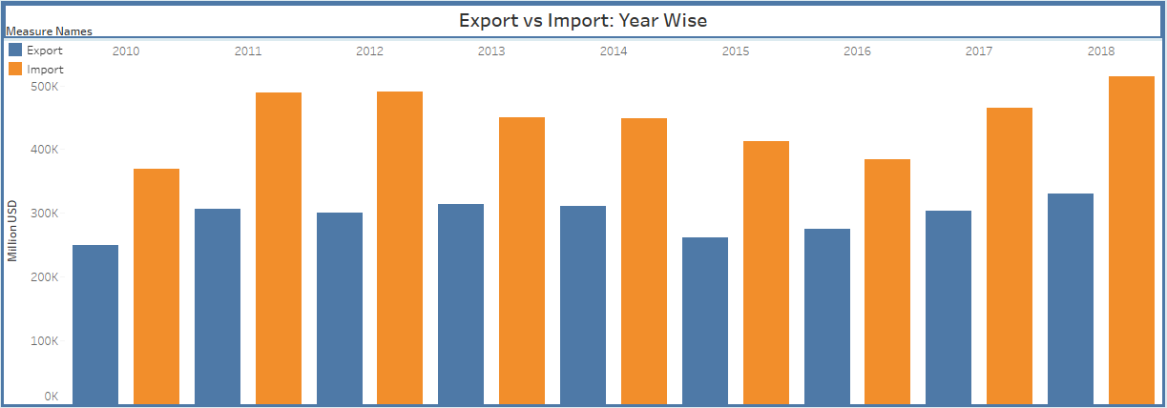

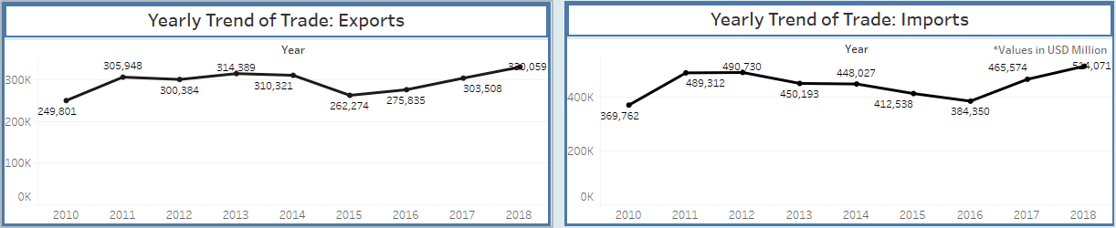
“Visualizing India's trade data to provide insights into most important sectors for development and efforts”
Question Statements
What is the overall trade across various geographies?
What is the value of export and import across various years?
Which commodity forms a major chunk of trade?
How has the trade between India and any given country grown over time?
00
Track Name
Track C: Data Visualization
Stakeholder Map
Ministry of Finance
Reserve Bank of India
Central Board of Excise and Customs
Team Name
Synergy
Ports & Logistics
Stakeholders in Foreign
Trade
Importers & Clearing Agents
Team Members
Aanchal Gaggar
Anurag Patnaik
Gautam Iyer
Shobhit Juyal
Utkarsha Patil
Ministry of Commerce & Industry
Insurance Agents
Commercial Banks & Merchant Banks
FERA
&
FEMA
Solution
We have built an Exim Dashboard analyzing the trade data across geographies in various years. This dashboard provides insights into India’s trade relations with various countries and a yearly trend from 2010 to 2018. It also helps us to obtain a birds eye view of the commodities in demand which have been regularly imported or exported from the country.
Team Collage
Graphs
Insights
Despite the global slowdown, India’s merchandise exports increased from USD 249.80 billion in 2010 to USD 330.05 billion in 2018.
The cumulative value of imports in 2010 was USD 369.76 billion as against USD 514.07 billion in 2018, registering an increase of 28 percent.
Coupled with the moderate growth in exports, this resulted in an increase in India’s trade deficit from USD 119.96 billion in 2010 to USD 184.013 billion in 2018, contributing to a higher Current Account Deficit (CAD).
Team Values
Authenticity
Collaboration
Innovation
Passion
Efficiency
Commitment
Way Ahead!
India’s foreign trade policy has helped to increase the country’s share of global trade from $2,49,801 to $3,30,059.
Through increase in domestic production of Top 5 commodities of Imports and ensuring their judicious use, can go a long way in reducing their dependence on imports.
All these steps will be a giant leap towards a favorable balance of trade.

